Slide 1

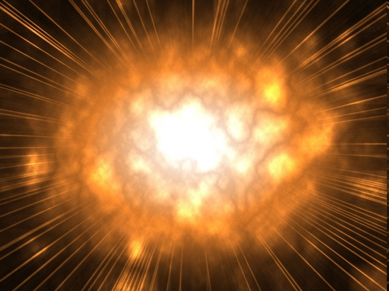
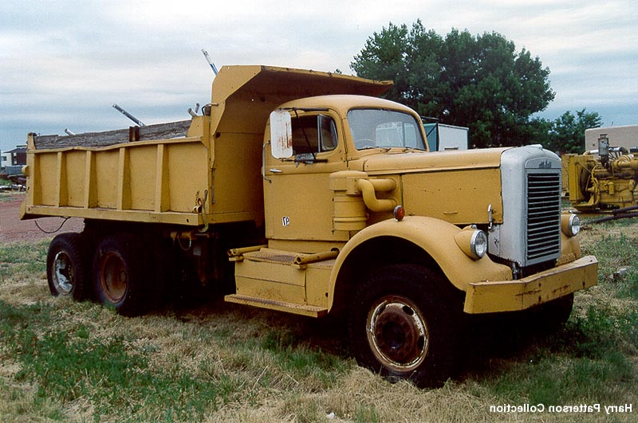

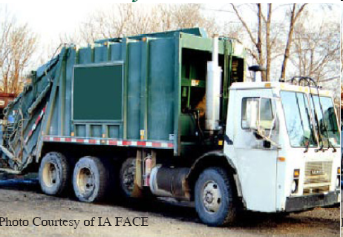
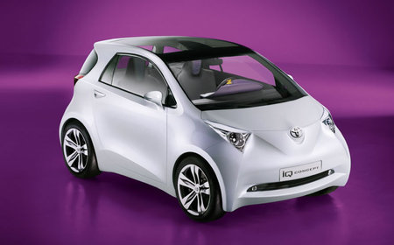
Our Reaction is Kind of Like This:
Imagine a bug…
flying very fast…
and there’s a garbage truck sitting there…
that our bug crashes into!!!
Oddly enough, the bug and
garbage truck are gone…
a dump truck & small
electric car appear
in the wake…
And they drive off into the sunset!
Make
Sense!?

Slide 2
Unlikely… but if it did happen, what physics rules must be followed?
Conservation of momentum (p_{before} = p_{after}).
Conservation of energy (KE_{BUG} = KE_{dump} + KE_{car}).
2A. Conservation of energy & mass (E = mc²).

Slide 3
Conservation of Momentum Restrictions
For each axis
p_{before} = p_{after}
p_{bug} + p_{garbage} = p_{dump} + p_{car}

Slide 4
Momentum Before the Collision
A 0.0001 kg bug is flying at a speed approaching light speed (3.0 x 10⁸ m/s) and crashes head on into a 16,000 kg garbage truck at rest.
In the axis of the bug’s motion.
The truck is not moving. This term = 0.
p_{before} = p_{bug} + p_{garbage}
p_{before} = (mv)_{bug} + (mv)_{garbage}
p_{before} = 0.0001kg(3 x 10⁸ m/s) + 0
p_{before} = 30,000 kg.m/s

Slide 5
Momentum After the Collision
Initial System
Momentum
(p_{y}) _{truck}
(p_{x}) _{truck}
p = 30,000 kg.m/s
x-axis only
(p_{x}) _{car}
(p_{y}) _{car}
(p_{x})_{car} + (p_{x})_{dump} = 30,000 kg.m/s
(p_{y})_{car} + (p_{y})_{truck} = 0 kg.m/s

Slide 6
What changes if…
the garbage truck idles and randomly rocks back and forth before the collision?
Initial p_{y} varies moment to moment.
Typically, the initial p_{y} ≠ 0 kg.m/s.
After collision y-axis momenta won’t cancel.

Slide 7
…Our Reaction is Really More Like The Simulated Model Below
neutrino + neutron → proton + muon
ν_{μ} + n⁰ → p⁺ + μ⁻
udd
uud
p⁺
υ_{μ−}
n⁰
μ⁻

Slide 8
… which is in 3-D!
Let’s welcome the z-axis.
An extra dimension of space =
an extra dimension of FUN!
z-axis
p⁺
υ_{μ−}
n⁰
μ⁻
Neutron at Rest
(p_{z})_{ν} + (p_{z})_{n} = (p_{z})_{p} + (p_{z})_{μ}
= (p_{z})_{ν}
(p_{x})_{ν} + (p_{x})_{n} = (p_{x})_{p} + (p_{x})_{μ}
= 0
= 0
(p_{y})_{ν} + (p_{y})_{n} = (p_{y})_{p} + (p_{y})_{μ}

